Slide 1
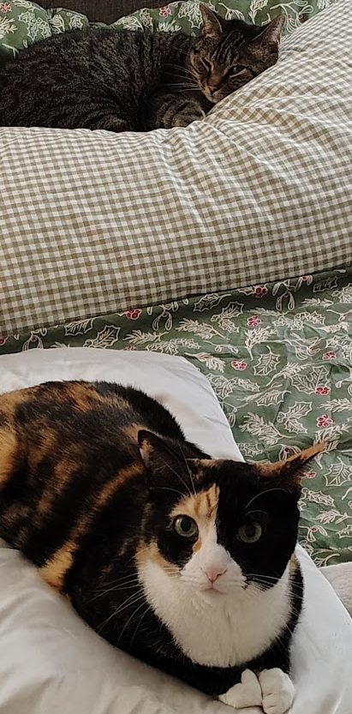
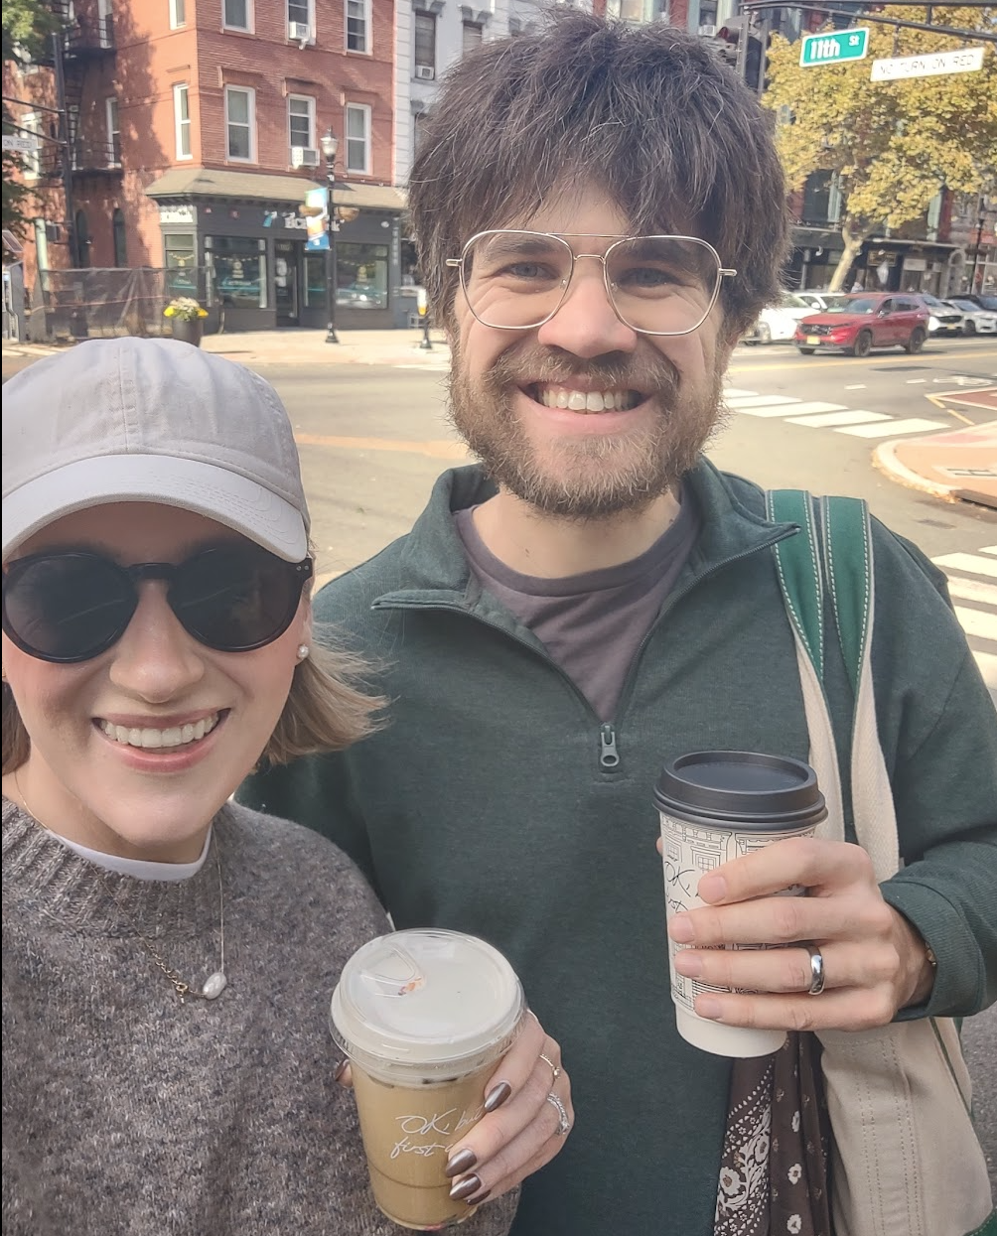



About Me

Slide 2
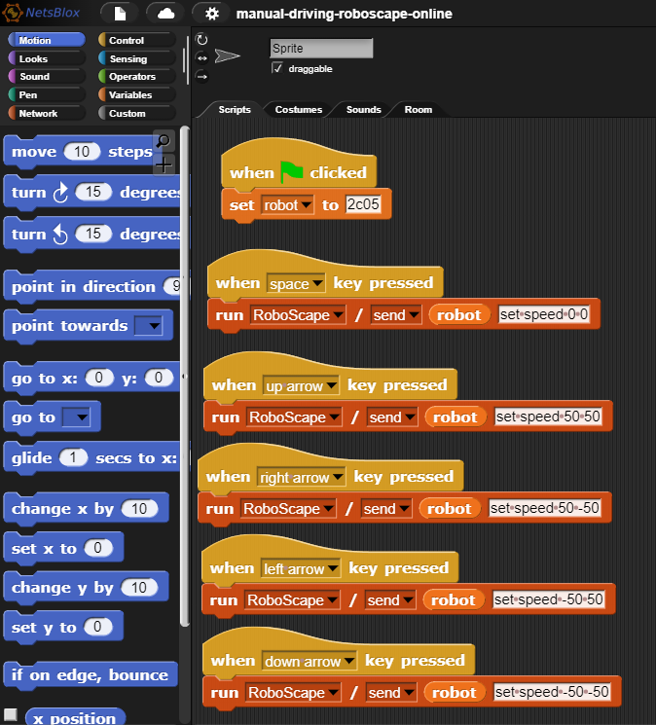
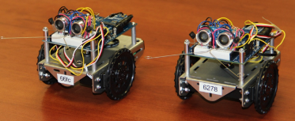
About Me

Slide 3














About Me

Slide 4
My Information
Office Hours: By appointment!
Office: EAS Annex 203
Email: byett1@stevens.edu
Zoom link: https://stevens.zoom.us/j/5589906600
I will prioritize in-person students over Zoom, but should generally be able to monitor both forms

Slide 5
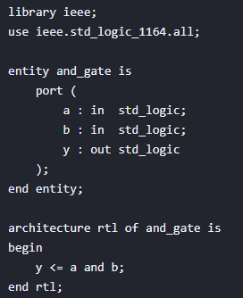
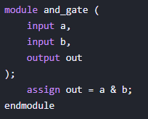
Ways to Design Hardware in Software
Traditional approaches – Hardware Description Languages (HDL) to write and test a hardware design
Small Verilog example on the left, VHDL on the right

Slide 6
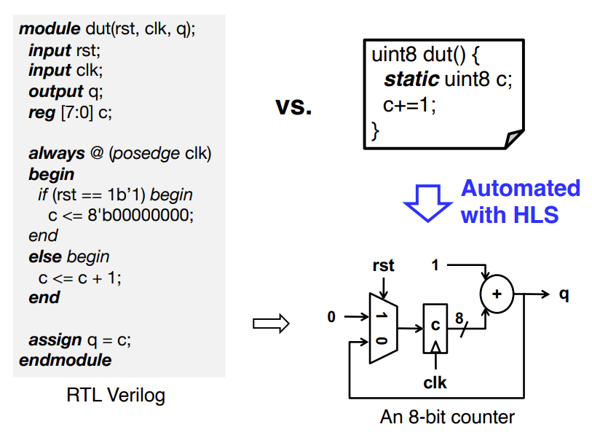
Ways to Design Hardware in Software
More recently – High Level Synthesis (HLS) to write in C/C++ and compile the equivalent hardware design
Gives up some control to the compiler, but much simpler programming-wise (source):

Slide 7
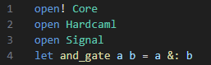
Ways to Design Hardware in Software
Most recently – Hardware Construction Languages (HCL) to describe hardware designs at a structural level within software programming language
Examples (outside of our Hardcaml) include Chisel, Clash, MyHDL, PyMtl, and SpinalHDL

Slide 8
Why Hardcaml?
Reuse standard OCaml tooling (i.e., editor integration, continuous integration).
Easily create highly parameterized designs - write a design once but instantiate it multiple different ways to suit different requirements.
Leverage the powerful OCaml type system to enforce invariants on our types.
Use standard software libraries across our hardware designs and testing frameworks. Quickcheck for testing is a hugely useful example.

Slide 9
Why (sometimes not) Hardcaml?
Some learning curve if you do not already know OCaml (as I have learned and some of you have learned!)
Generated HDL code (for use with vendor tooling like Vivado or Quartus) is computer generated and nothing like what a human would write.
Hardcaml makes up names in generated code that look like _8277. This isn't very helpful when reading the logs from vendor tools.
We have some tricks we can play here to make things a bit easier.

Slide 10
Nexys A7
The NI Digilent Nexys A7 is a rebrand of the Nexys 4 DDR board
The Nexys A7-100T variant (which we will almost entirely be using) is functionally identical to the Nexys 4 DDR.
The Nexys A7-100T contains 15,850 logic slices each with 4 look-up tables (LUTs) and 8 flip-flops.
A Xilinx Design Constraints (XDC) file provides the physical pins on the FPGA in relation to the HDL code
Most of this will be handled for us in this class

Slide 11
Hexadecimal Numbers
Hex Digit | Decimal Equivalent | Binary Equivalent
0 | 0 | 0000
1 | 1 | 0001
2 | 2 | 0010
3 | 3 | 0011
4 | 4 | 0100
5 | 5 | 0101
6 | 6 | 0110
7 | 7 | 0111
8 | 8 | 1000
9 | 9 | 1001
A | 10 | 1010
B | 11 | 1011
C | 12 | 1100
D | 13 | 1101
E | 14 | 1110
F | 15 | 1111

Slide 12
Single-Input Logic Gates

Slide 13
Two-Input Logic Gates

Slide 14
More Two-Input Logic Gates

Slide 15
Multiple-Input Logic Gates
Multi-input XOR: Odd parity (aka a result of 1 if an odd number of inputs are 1, and a result of 0 otherwise) - TPS

Slide 16
Types of Logic Circuits
Combinational Logic
Memoryless
Outputs determined by current values of inputs
Sequential Logic
Has memory
Outputs determined by previous and current values of inputs

Slide 17
Sum-of-Products (SOP) Form
$$Y=F\left(A,B\right)= \overline{A}B+AB$$

Slide 18
Product-of-Sums (POS) Form
maxterms
$$A+B$$
$$A+\overline{B}$$
$$\overline{A}+B$$
$$\overline{A}+\overline{B}$$
$$Y=(A+B)(\overline{A}+B)$$

Slide 19
Boolean Axioms
Number | Axiom | Dual | Name
A1 | B = 0 if B ≠ 1 | B = 1 if B ≠ 0 | Binary Field
A2 | 0 = 1 | 1 = 0 | NOT
A3 | 0 • 0 = 0 | 1 + 1 = 1 | AND/OR
A4 | 1 • 1 = 1 | 0 + 0 = 0 | AND/OR
A5 | 0 • 1 = 1 • 0 = 0 | 1 + 0 = 0 + 1 = 1 | AND/OR
Dual: Replace: • with +
0 with 1

Slide 20
Boolean Theorems of One Variable
Number | Theorem | Dual | Name
T1 | B • 1 = B | B + 0 = B | Identity
T2 | B • 0 = 0 | B + 1 = 1 | Null Element
T3 | B • B = B | B + B = B | Idempotency
T4 | B = B |  | Involution
T5 | B • B = 0 | B + B = 1 | Complements
Dual: Replace: • with +
0 with 1

Slide 21
Boolean Theorems of Several Vars
Number | Theorem | Name
T6 | B•C = C•B | Commutativity
T7 | (B•C) • D = B • (C • D) | Associativity
T8 | B • (C + D) = (B•C) + (B•D) | Distributivity
T9 | B• (B+C) = B | Covering
T10 | (B•C) + (B•C) = B | Combining
T11 | (B•C) + (B•D) + (C•D) = (B•C) + (B•D) | Consensus

Slide 22
DeMorgan’s Theorem: Dual
# | Theorem | Dual | Name
T12 | B₀•B₁•B₂… = B₀+B₁+B₂… | B₀+B₁+B₂… = B₀•B₁•B₂… | DeMorgan’s Theorem
The complement of the product
is the
sum of the complements.
Dual: The complement of the sum
is the
product of the complements.

Slide 23

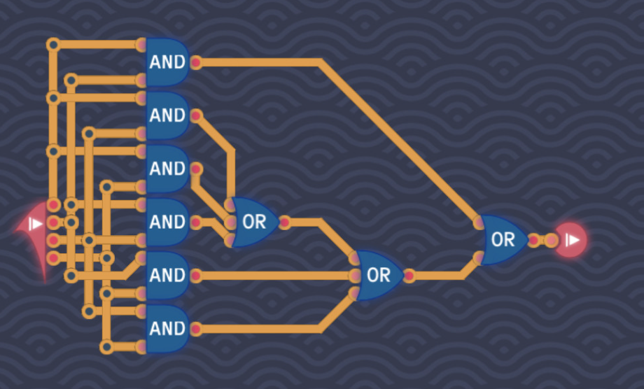
Brief Aside: Turing Complete (not sponsored)

Slide 24
Challenge Task: Logic
Use 5 3-bit inputs (A through E) to produce a single 3-bit output (Y)
One additional input (I) that represents an optional inverter at the very end of the rest of the logic (i.e. when I=1, invert the output; when I=0, use the output determined by the remaining logic)
Each input bit should be associated with a switch
Each output bit should be associated with a LED
Logic expressed by the truth table on the provided document
Up to you how you handle reducing (or otherwise using) this logic

